Slide 1



Course Name software Development project management
CSC 4125
(Undergraduate)
Chapter 5 Approach selection
Software engineering (Undergraduate)
M. Mahmudul hasan
Assistant Professor, CS, AIUB
http://www.dit.hua.gr/~m.hasan

Slide 2
In-house software development
MMH
In-House Software Development usually means
Project team and users belong to same organization
Applications being considered slot into a portfolio of existing computer-based systems
Methodologies and technologies to be used are not selected by the project manager, but dictated by local standards
However, where successive projects are carried out for different customers, methodologies and technologies need to be reviewed for each individual project

Slide 3
Off-The-Shelf (OTS) software
MMH
Instead of developing a software component from scratch, organizations occasionally purchase off-the-shelf (OTS) components from third-party vendors and integrate them with their own components.
Advantages
Cheaper as supplier can spread development costs over a large number of customers
Development time is reduced. Software already exists
More reliable because the SW is well-debugged and well-proven where lots of people have already used the software, most of the bugs are likely to have been reported and removed

Slide 4
Off-The-Shelf (OTS) software
MMH
Limitation
A major issue that can arise while integrating different components is mismatches among code pieces developed by different parties usually unaware of each other.
Customer will have same application as everyone else: no competitive advantage, but competitive advantage may come from the way application is used.
Dependence on vendor: Customer does not own the code
Danger of over-reliance on a single supplier
Stability of the vendor –Vendors can go out of business, can be purchased by other companies or completely drop support for a product

Slide 5
Choosing technologies
MMH
Technologies might include application-building and automated testing environments
Technology will influence:
training required for the development staff
types of staff to be recruited
development environment – both hardware and software
maintenance arrangements
Identify project as objectives driven (solution to a problem) or product driven (opportunities)
Analyze other project characteristics

Slide 6
Choosing technologies
MMH
Is it data-oriented (information system, database intensive) or process oriented system (embedded system control) to be implemented?
Will the software that is to be produced be a general software or application specific?
Is the application to be implemented of a particular type for which specific tools have been developed?
Does it involve concurrent processing?
Will the system to be created be knowledge-based (expert advice in decision making)?
Will the system to be used make heavy use of computer graphics?
Is the system to be created safety critical? (not suit for agile methodologies)
What is the nature of the hardware/software environment in which the system will operate? (embedded software vs. personal computer)

Slide 7
Identify high-level project risk
MMH
Product Uncertainty – how well the requirements are understood
Process Uncertainty – introducing new method creates uncertainty in the development process
Resource Uncertainty – availability of staff (experienced)

Slide 8
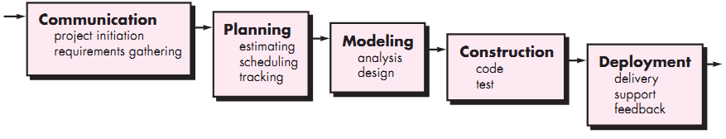
Waterfall model
MMH
Slide-8
Waterfall model is a linear sequential model which is also called classical model of software development
Problems of Waterfall model
Inflexible partitioning of the project into distinct stages
This makes it difficult to respond to changing customer requirements
Therefore, this model is only appropriate when the requirements are well-understood

Slide 9
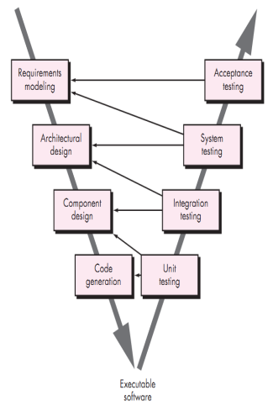
V - model
Slide-9
MMH
The V-model is a SDLC model where execution of processes happens in a sequential manner in V-shape. It is also known as Verification and Validation model.
V-Model is an extension of the waterfall model and is based on association of a testing phase for each corresponding development stage. This means that for every single phase in the development cycle there is a directly associated testing phase.
This is a highly disciplined model and next phase starts only after completion of the previous phase.

Slide 10
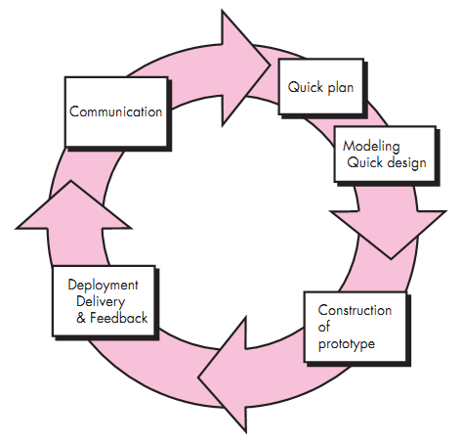
Prototyping model
MMH
Slide-10
Advantages of Prototyping Model
Learning by doing
Improved user involvement and communication
Clarification of partially known requirements
Reduced maintenance costs
Demonstration of consistency and completeness of a specification
Production of expected results
Throw-away Prototyping
Evolutionary Prototyping

Slide 11
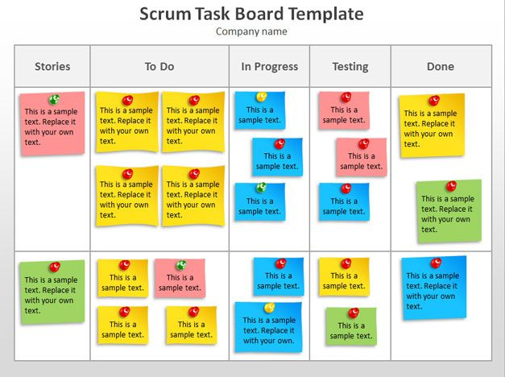
SCRUM: An Agile Development
MMH
Slide-11

Slide 12
references
MMH
Bob Hughes and Mike Cotterel (1999). Software Project Management (Second Edition).
PMBOK Guide: Project Lifecycle (5th Edition)

